Slide 1

Chapter 1: Computer Networks and the Internet

Slide 2
Roadmap
What is the Internet?
Network Edge
end systems, access networks, links
Network Core
packet switching, circuit switching, network structure
Delay, loss, throughput in networks
Protocol layers, Service models
Networks under attack: security
History

Slide 3
What’s the Internet: “Nuts and Bolts”view
Internet : The Internet is a computer network that interconnects hundreds of millions of computing devices throughout the world
Hosts or End systems : Systems that are connected to Internet
Communication links : Coaxial cable, Copper wire, Optical fiber, and Radio spectrum
Transmission rate : measured in bits/second
Packet switches types : Routers and Link-layer switches
Routers : Used in network core
Link layer switches : Used in access networks

Slide 4
Protocols : controls the sending and receiving of information within the Internet
Most important protocols in the Internet :
Transmission Control Protocol (TCP)
Internet Protocol (IP)
Internet standards are developed by the Internet Engineering Task Force (IETF)
The IETF standards documents are called requests for comments (RFCs)
There are currently more than 6,000 RFCs

Slide 5
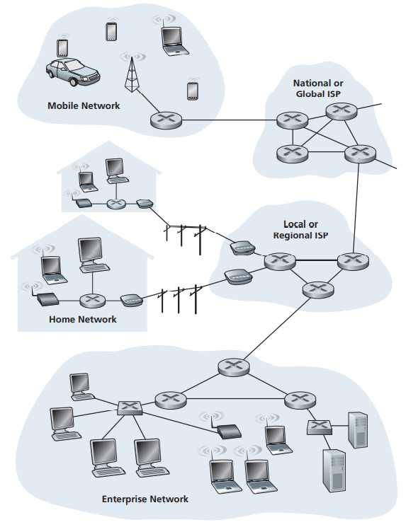
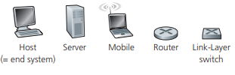

Some pieces of the Internet

Slide 6
What’s the Internet : A Service View
An infrastructure that provides services to applications :
electronic mail, Web surfing, social networks, instant messaging, Voiceover-IP (VoIP), video streaming, distributed games, peer-to-peer (P2P) file sharing, television over the Internet, remote login etc.
The applications are said to be distributed applications, since they involve multiple end systems that exchange data with each other.
End systems attached to the Internet provide an Application Programming Interface (API)
Internet API is a set of rules that the sending program must follow so that the Internet can deliver the data to the destination program.

Slide 7
What is a Protocol
A protocol defines the format and the order of messages exchanged between two or more communicating entities, as well as the actions taken on the transmission and/or receipt of a message or other event.
A Human Analogy:
When people run different protocols, the protocols do not interoperate, and no useful work can be accomplished.
It takes two or more communicating entities running the same protocol in order to accomplish a task.

Slide 8
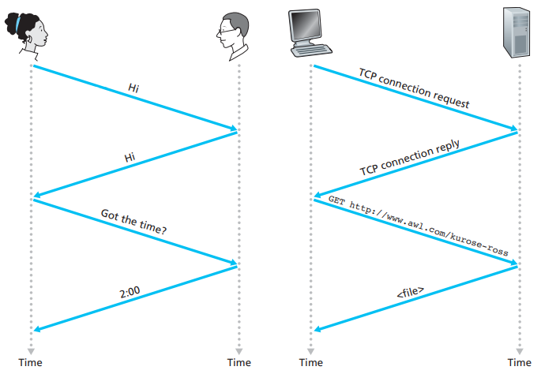
A human protocol and a computer network protocol

Slide 9
What is a Protocol
Network Protocols:
A network protocol is like a human protocol, except that the entities exchanging messages and taking actions are hardware or software components.
All activity in the Internet that involves two or more communicating remote entities is governed by a protocol.
Example:
hardware-implemented protocols in two physically connected computers control the flow of bits on the “wire” between the two network interface cards
congestion-control protocols in end systems control the rate at which packets are transmitted between sender and receiver
protocols in routers determine a packet’s path from source to destination

Slide 10
The Network Edge

Slide 11
The Network Edge
End systems : the computers and other devices connected to the Internet
End systems include:
desktop computers (e.g., desktop PCs, Macs, and Linux boxes),
servers (e.g., Web and e-mail servers), and
mobile computers (e.g., laptops, smartphones, and tablets).
Hosts are divided into two categories:
Clients: desktop and mobile PCs, smartphones, etc.
Servers: more powerful machines that store and distribute Web pages, stream video, relay e-mail, etc.

Slide 12
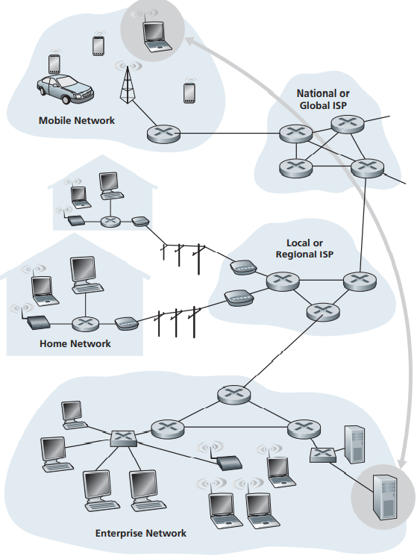
End-system interaction

Slide 13
The Network Edge : Access Networks
Access network:
the network that physically connects an end system to the first router
First router is also known as the “edge router”

Slide 14
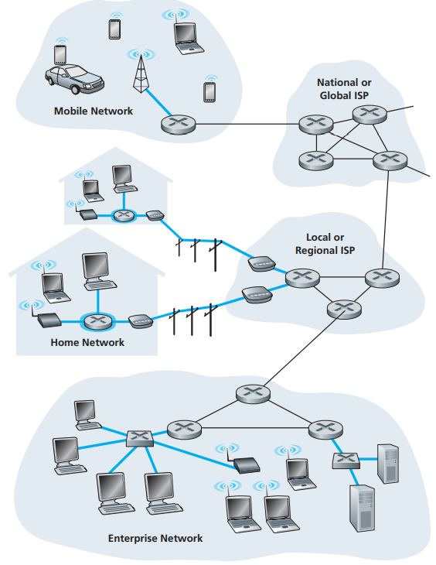
Access Networks

Slide 15
Home Access: DSL, Cable, FTTH, Dial-Up, and Satellite links
Two most prevalent types of broadband residential access are:
Digital Subscriber Line (DSL) and
Cable
Digital Subscriber Line
The residential telephone line carries both data and traditional telephone signals which are encoded at different frequencies:
A high-speed downstream channel, in the 50 kHz to 1 MHz band
A medium-speed upstream channel, in the 4 kHz to 50 kHz band
An ordinary two-way telephone channel, in the 0 to 4 kHz band

Slide 16
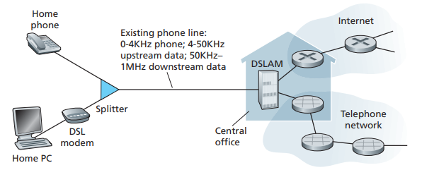
Home Access: DSL, Cable, FTTH, Dial-Up, and Satellite
Splitter: separates the data and telephone signals
DSLAM: separates the data and phone signals

Slide 17
Home Access: DSL, Cable, FTTH, Dial-Up, and Satellite
Cable Internet access:
makes use of the cable television company’s existing cable television infrastructure.
Fiber optics connect the cable head end to neighborhood-level junctions
Coaxial cable is then used to reach individual houses and apartments
Each neighborhood junction typically supports 500 to 5,000 homes

Slide 18
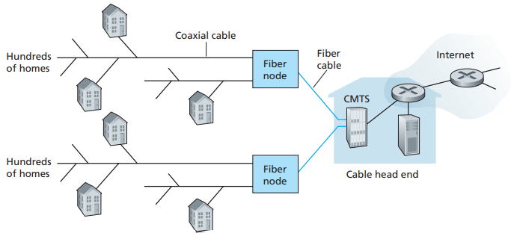
Home Access: DSL, Cable, FTTH, Dial-Up, and Satellite
Cable modem termination system (CMTS):
turning the analog signal sent from the cable modems in many downstream homes back into digital format.
A hybrid fiber-coaxial access network

Slide 19
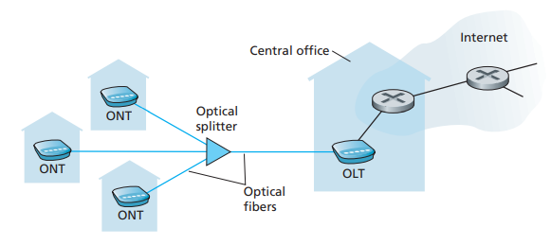
Home Access: DSL, Cable, FTTH, Dial-Up, and Satellite
FTTH(fiber to the home):
up-and-coming technology that promises even higher speeds
Concept is to provide an optical fiber path from the CO directly to the home
FTTH Internet Access

Slide 20
Home Access: DSL, Cable, FTTH, Dial-Up, and Satellite
Each home has an optical network terminator (ONT)
ONT is connected by dedicated optical fiber to a neighborhood splitter
The splitter combines several homes onto a single, shared optical fiber, which connects to an optical line terminator (OLT)
The OLT, providing conversion between optical and electrical signals, connects to the Internet via a telco router
In the home, users connect a home router to the ONT and access the Internet via this home router

Slide 21
Home Access: DSL, Cable, FTTH, Dial-Up, and Satellite
In locations where DSL, cable, and FTTH are not available
a satellite link can be used to connect a residence to the Internet at speeds of more than 1 Mbps
StarBand and HughesNet are two such satellite access providers.
Dial-up access over traditional phone lines is based on the same model as DSL—a home modem connects over a phone line to a modem in the ISP.
Compared to other broadband access networks, dial-up access is extremely slow at 56 kbps.

Slide 22
Access in the Enterprise (and the Home): Ethernet and WiFi
On corporate and university campuses, a LAN is used to connect an end system to the edge router
Ethernet is by far the most prevalent access technology in corporate, university, and home networks
Ethernet users use twisted-pair copper wire to connect to an Ethernet switch
With Ethernet access,
users have 100 Mbps access to the Ethernet switch, whereas
servers may have 1 Gbps or even 10 Gbps access.

Slide 23
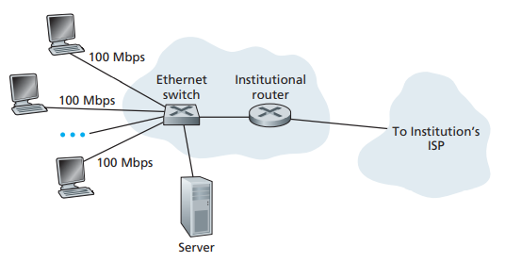
Access in the Enterprise (and the Home): Ethernet and WiFi
Ethernet Internet access

Slide 24
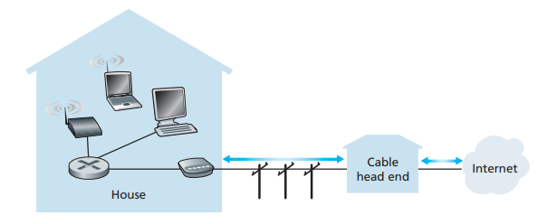
Access in the Enterprise (and the Home): Ethernet and WiFi
In a wireless LAN setting:
wireless users transmit/receive packets to/from an access point that is connected into the enterprise’s network which in turn is connected to the wired Internet
A typical home network

Slide 25
Wide-Area Wireless Access: 3G and LTE
Telecommunications companies have made enormous investments in third-generation (3G) wireless, which provides wide-area wireless Internet access at speeds in excess of 1 Mbps.
Even higher-speed wide-area access technologies—a fourth-generation (4G) of wide-area wireless networks—are already being deployed.
LTE (Long-Term Evolution) has its roots in 3G technology and can potentially achieve rates in excess of 10 Mbps.

Slide 26
Physical Media

Slide 27
Physical Media
Physical medium can take many shapes and forms and does not have to be of the same type for each transmitter-receiver pair along the path.
Physical media fall into two categories:
Guided media : the waves are guided along a solid medium
Unguided media : the waves propagate in the atmosphere and in outer space
Examples of physical media include:
twisted-pair copper wire,
coaxial cable,
multimode fiber-optic cable,
terrestrial radio spectrum, and
satellite radio spectrum.

Slide 28
Twisted-Pair Copper Wire
Least expensive
Most commonly used
Used by telephone networks
Twisted pair consists of :
two insulated copper wires,
each about 1 mm thick,
arranged in a regular spiral pattern.
The wires are twisted together to reduce the electrical interference from similar pairs close by

Slide 29
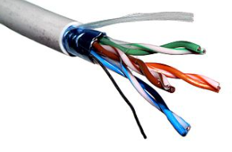
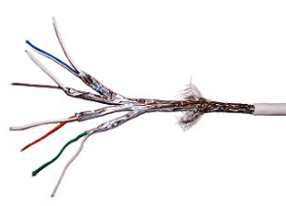
Twisted-Pair Copper Wire
Two Types :
UTP
Commonly used for computer networks within a building, for LANs.
Data rates for LANs using twisted pair today range from 10 Mbps to 10 Gbps.
STP
Twisted pair cables incorporate shielding to prevent electromagnetic interference.

Slide 30
Comparison Chart
BASIS FOR COMPARISON | UTP | STP
Basic | UTP (Unshielded twisted pair) is a cable with wires that are twisted together. | STP (Shielded twisted pair) is a twisted pair cable enclosed in foil or mesh shield.
Noise and crosstalk generation | High comparatively. | Less susceptible to noise and crosstalk.
Grounding cable | Not required | Necessarily required
Ease of handling | Easily installed as cables are smaller, lighter, and flexible. | Installation of cables is difficult comparatively.
Cost | Cheaper and does not require much maintenance. | Moderately expensive.
Data Rates | Slow comparatively. | Provides high data rates

Slide 31
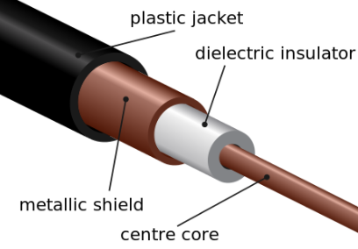
Coaxial Cable
Coaxial cable consists of two copper conductors, but the two conductors are concentric rather than parallel
High data transmission rates
Common in cable television systems
Coaxial cable can be used as a guided shared medium.

Slide 32
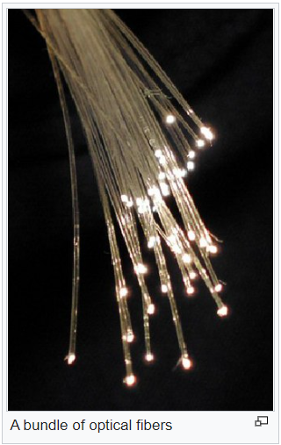
Fiber Optics
An optical fiber is a thin, flexible medium
Conducts pulses of light, with each pulse representing a bit.
A single optical fiber can support tremendous bit rates, up to tens or even hundreds of gigabits per second
They are immune to electromagnetic interference
Have very low signal attenuation up to 100 kilometers
The Optical Carrier (OC) standard link speeds range from 51.8 Mbps to 39.8 Gbps
Standards in use today include OC-1, OC-3, OC-12, OC-24, OC-48, OC-96, OC-192, OC-768.

Slide 33
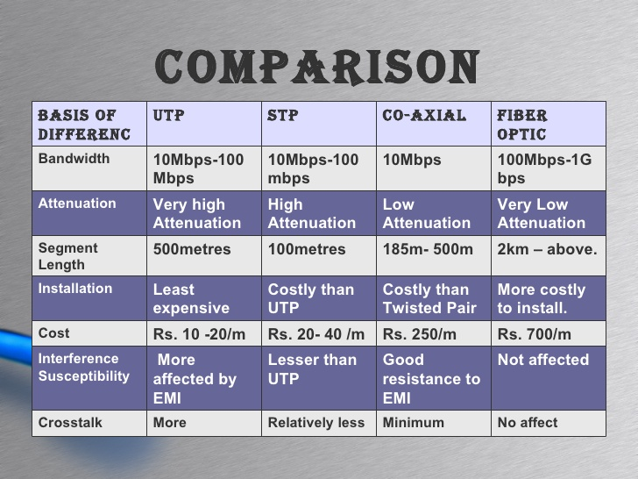
Comparision
In transmitting electronic signals, attenuation is the loss of signal strength as measured in decibels (dB).

Slide 34
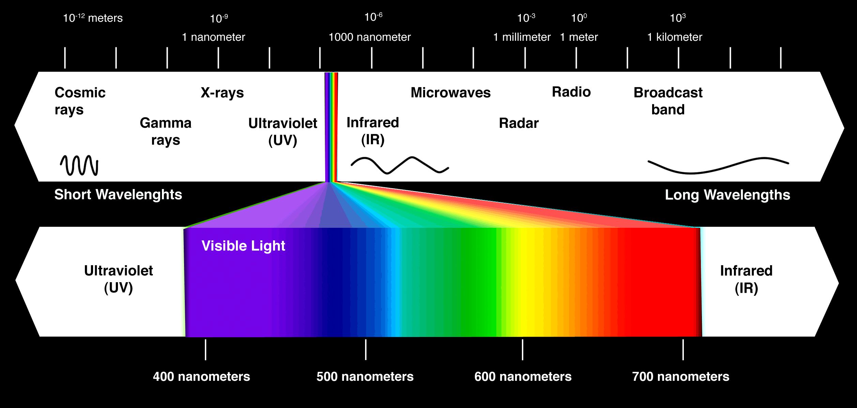
Terrestrial Radio Channels
Radio channels carry signals in the electromagnetic spectrum
They require no physical wire to be installed
Provide connectivity to a mobile user
Characteristics of a radio channel depend significantly on the propagation environment and the distance

Slide 35
Terrestrial Radio Channels
Terrestrial radio channels can be broadly classified into three groups :
those that operate over very short distance (e.g., with one or two meters)
wireless headsets, keyboards,
those that operate in local areas, typically spanning from ten to a few hundred meters
wireless LAN technologies
those that operate in the wide area, spanning tens of kilometers
cellular access technologies use wide-area radio channels

Slide 36
Satellite Radio Channels
A communication satellite links two or more Earth-based microwave transmitter/ receivers, known as ground stations.
The satellite receives transmissions on one frequency band
Regenerates the signal using a repeater and
Transmits the signal on another frequency.
Two types of satellites are used in communications:
Geostationary satellites and
Low-earth orbiting (LEO) satellites.

Slide 37
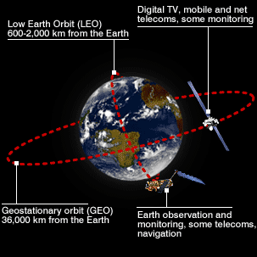
Satellite Radio Channels
Geostationary satellites permanently remain above the same spot on Earth
LEO satellites are placed much closer to Earth and do not remain permanently above one spot on Earth
They rotate around Earth

Slide 38
The Network Core

Slide 39
PACKET SWITCHING
In a network application, end systems exchange messages with each other
Messages may perform a control function or can contain data, such as an email message, a JPEG image, or an MP3 audio file
The source breaks long messages into smaller chunks of data known as packets
Each packet travels through communication links and packet switches
Packets are transmitted at a rate equal to the full transmission rate of the link
The time to transmit the packet is L/R seconds

Slide 40
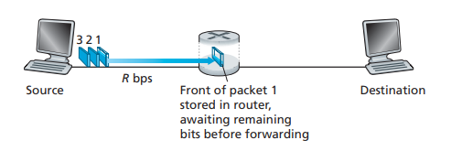
Packet-Switching: Store-and-Forward
Packet switches use store-and-forward transmission at the inputs to the links
Packet switch must receive the entire packet before it can transmit

Slide 41
Packet-Switching: Store-and-Forward
takes L/R seconds to transmit (push out) L-bit packet into link at R bps
store and forward: entire packet must arrive at router before it can be transmitted on next link
end-end delay = N*L/R (assuming zero propagation delay)
routers need to receive, store, and process the entire packet before forwarding.
one-hop numerical example:
L = 7.5 Mbits
R = 1.5 Mbps
one-hop transmission delay = 5 sec

Slide 42
Packet Switching: queueing delay, loss
Each packet switch has multiple links attached to it
For each attached link, the packet switch has an output buffer/output queue
Output buffer : stores packets that the router is about to send into that link
Output buffer queuing delays : an arriving packet needs to be transmitted onto a link but finds the link busy, the arriving packet must wait in the output buffer
Delays are variable and depend on the level of congestion in the network
Packet loss — either the arriving packet or one of the already-queued packets will be dropped

Slide 43
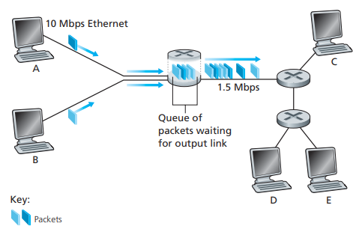
Packet switching

Slide 44
Forwarding Tables and Routing Protocols
In the Internet, every end system has an address called an IP address
Each router has a forwarding table
Forwarding table : maps destination addresses to that router’s outbound links
Internet has a few special routing protocols that are used to automatically set the forwarding tables

Slide 45
Forwarding Tables and Routing Protocols
Routing: determines source-destination route taken by packets
Forwarding: move packets from router’s input to appropriate router output
routing algorithm
local forwarding table
header value
output link
0100
0101
0111
1001
3
2
2
1
1
3
2
0111
dest address in arriving
packet’s header

Slide 46
CIRCUIT SWITCHING
Two fundamental approaches to moving data through a network of links and switches:
Packet switching and
Circuit switching
Circuit Switching : Resources needed for communication are reserved for the duration of the communication session
Traditional telephone networks are examples of circuit-switched networks

Slide 47
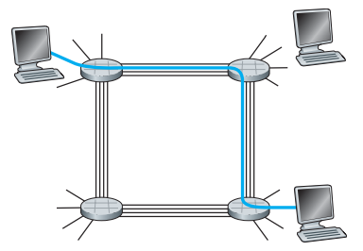
A simple circuit-switched network consisting of four switches and four links
If each link between adjacent switches has a transmission rate of 1 Mbps
then each end-to-end circuit-switch connection gets 250 kbps of dedicated transmission rate.

Slide 48
Multiplexing in Circuit-Switched Networks
A circuit in a link is implemented with either
Frequency-division multiplexing (FDM) or
Time-division multiplexing (TDM)
FDM
The frequency spectrum of a link is divided up among the connections established across the link
In telephone networks, this frequency band typically has a width of 4 kHz
The width of the band is called the bandwidth
FM radio stations also use FDM to share the frequency spectrum between 88 MHz and 108 MHz

Slide 49
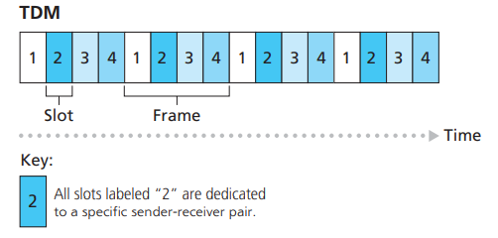
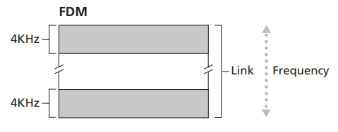
Multiplexing in Circuit-Switched Networks
TDM
Time is divided into frames of fixed duration
Each frame is divided into a fixed number of time slots
When the network establishes a connection across a link, the network dedicates one time slot in every frame to this connection

Slide 50
Multiplexing in Circuit-Switched Networks
The transmission rate of a circuit is equal to the frame rate multiplied by the number of bits in a slot
Example : if the link transmits 8,000 frames per second and each slot consists of 8 bits, then the transmission rate of a circuit is 64 kbps.

Slide 51
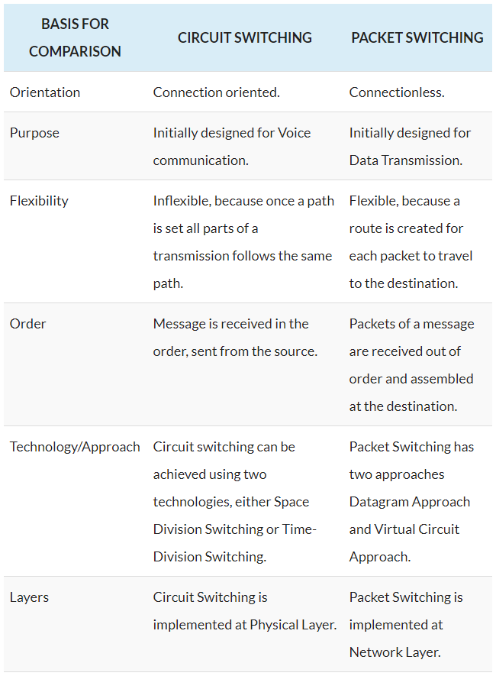
Circuit Switching Vs Packet Switching
For Data transmission, Packet Switching is the more efficient than Circuit Switching whereas,
When it comes to voice transmission Circuit switching is more efficient than packet switching.

Slide 52
A NETWORK OF NETWORKS
End systems connect into the Internet via an access ISP
The access ISP can provide either wired or wireless connectivity
Using technologies including DSL, cable, FTTH, Wi-Fi, and cellular
The access ISPs themselves must be interconnected; this is done by creating a network of networks

Slide 53
Network Structure 1
Interconnects all the access ISPs with a single global transit ISP
Global transit ISP is a network of routers and communication links that spans the globe
Global transit ISP also has at least one router near each of the hundreds of thousands of access ISPs
Since the access ISP pays the global transit ISP
the access ISP is said to be a customer and
the global transit ISP is said to be a provider
If a company builds a global transit ISP and is profitable then it’s natural for other companies to build their own global ISPs and compete with the original

Slide 54
Network Structure 2
Consists of the hundreds of thousands of access ISPs and multiple global transit ISPs
The access ISPs certainly prefer Network Structure 2 over Network Structure 1
Based on pricing and service, ISPs can choose among competing Global transit ISPs
Global transit ISPs themselves must be interconnected :
Otherwise access ISPs connected to one of the global transit providers would not be able to communicate with access ISPs connected to the other global transit provider

Slide 55
A Network Of Networks
In any given region,
There may be a regional ISP to which the access ISPs in the region connect
Each regional ISP then connects to tier-1 ISPs
Tier-1 ISPs are like global transit ISP
Each access ISP pays the regional ISP, and regional ISP pays Tier-1 ISPs
There is customer-provider relationship at each level of the hierarchy

Slide 56
A Network Of Networks
PoP : a group of one or more routers (at the same location) in the provider’s network
Internet Exchange Point (IXP) - typically in a stand-alone building with its own switches
There are roughly 300 IXPs in the Internet today

Slide 57
Network Structure 5
The Internet of 2012
Network structure 5 builds on top of Network Structure 4 by adding content provider networks (Google)
Today’s Internet—a network of networks—is complex, consisting of a dozen or so tier-1 ISPs and hundreds of thousands of lower-tier ISPs

Slide 58
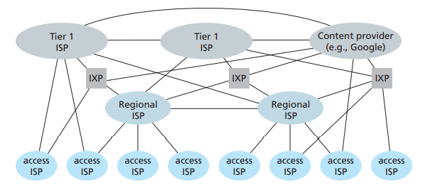
Interconnection of ISPs

Slide 59
Delay, Loss & Throughput in Packet-Switched Networks

Slide 60
Overview of Delay in Packet-Switched Networks
A packet suffers several types of delays at each node along the path
Types of delays :
Nodal processing delay,
Queuing delay,
Transmission delay, and
Propagation delay
Together, these delays accumulate to give a total nodal delay

Slide 61
Types of Delay
Processing Delay :
time required to examine the packet’s header and determine where to direct the packet
Queuing Delay :
at the queue/buffer, packet waits to be transmitted onto the link
Transmission Delay :
amount of time required to push or transmit all of the packet’s bits into the link
Propagation Delay :
time required to propagate from the beginning of the link to router B

Slide 62
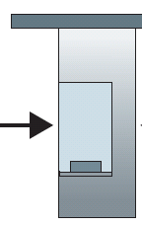
Comparing Transmission and Propagation Delay
Caravan analogy
cars “propagate” at 100 km/hr
toll booth takes 12 sec to service car (bit transmission time)
Car ~ bit
Caravan ~ packet
Q: How long until caravan is lined up before 2nd toll booth?
100 km
100 km
ten-car
caravan
toll
booth
toll
booth
time to “push” entire caravan through toll booth onto highway = 12*10 = 120 sec = 2 min
time for last car to propagate from 1st to 2nd toll both: 100km/(100km/hr)= 1 hr
A: 62 minutes

Slide 63
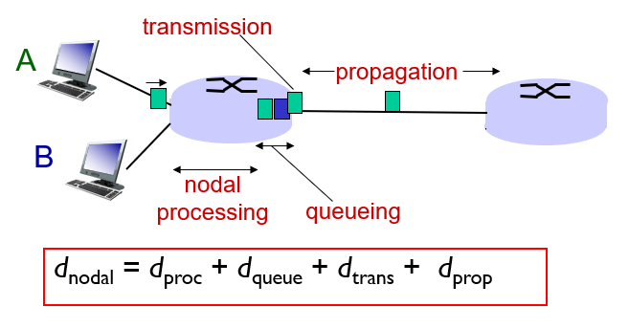
Four Sources of a Packet Delay
d_{proc}: nodal processing
check bit errors
determine output link
typically < msec
d_{queue}: queueing delay
time waiting at output link for transmission
depends on congestion level of router

Slide 64
Four Sources of a Packet Delay
d_{trans}: transmission delay:
L: packet length (bits)
R: link bandwidth (bps)
d_{trans} = L/R
d_{prop}: propagation delay:
d: length of physical link
s: propagation speed in medium (~2x10⁸ m/sec)
d_{prop} = d/s

Slide 65
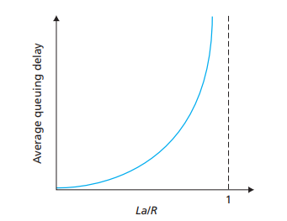

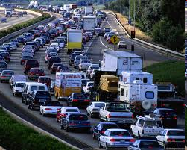
Queueing delay (again)
R: link bandwidth (bps)
L: packet length (bits)
a: average packet arrival rate
The ratio La/R, called the traffic intensity
La/R ~ 0: avg. queueing delay small
La/R > 1: avg. queueing delay large
La/R > 1: more“work”arriving
than can be serviced, average delay infinite!
La/R ~ 0
La/R -> 1

Slide 66
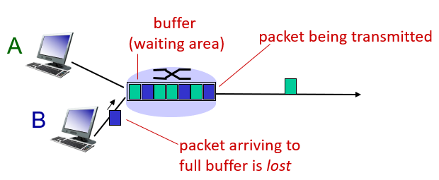
Packet loss
Queue (or buffer) preceding a link has finite capacity
Packet arriving to full queue will be dropped (or lost)
Lost packet may be retransmitted by previous node, by source end system, or not at all

Slide 67

End-to-End Delay
Suppose that the network is uncongested
queuing delays are negligible
d_{trans} = L/R, where L is the packet size

Slide 68
Traceroute
To get a hands-on feel for end-to-end delay, we can use the Traceroute program
Traceroute
a simple program that can run in any Internet host

Slide 69
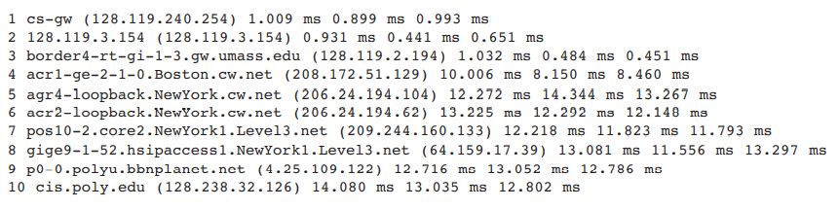
Example
Output of a traceroute program :

Slide 70
Throughput in Computer Networks
Instantaneous throughput at any instant of time is the rate (in bits/sec) at which Host B is receiving the file.
If the file consists of F bits and the transfer takes T seconds for Host B to receive all F bits
then the average throughput of the file transfer is F/T bits/sec

Slide 71
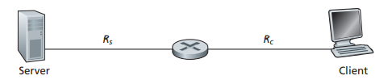
Throughput
the server cannot pump bits through its link at a rate faster than R_{s} bps
the router cannot forward bits at a rate faster than R_{c} bps
If R_{s} < R_{c} , throughput is R_{s} bps
If R_{c} < R_{s} , end-to-end throughput is R_{c}
Here, the throughput is min{R_{c} , R_{s}}, it is the transmission rate of the bottleneck link

Slide 72
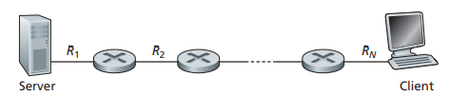
Throughput
A network with N links between the server and the client
Transmission rates of the N links being R₁, R₂,..., R_{N}
Throughput for a file transfer from server to client is min{R₁, R₂,..., R_{N}}

Slide 73
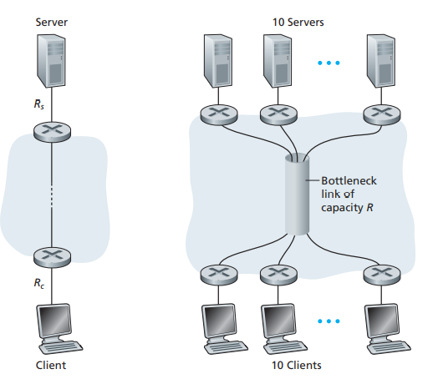
Example motivated by today’s Internet
R is the transmission rate of the core link
All server access links have the same rate R_{s}
All client access links have the same rate R_{c}
If the rate of the common link, R, is large than both R_{s} and R_{c}
the throughput for each download will be min{R_{s} , R_{c} }

Slide 74
Protocol Layers And Their Service Models

Slide 75
Introduction
There are many pieces to the Internet :
numerous applications and protocols,
various types of end systems,
packet switches, and
various types of link-level media
Question:
is there any hope of organizing a network architecture?

Slide 76
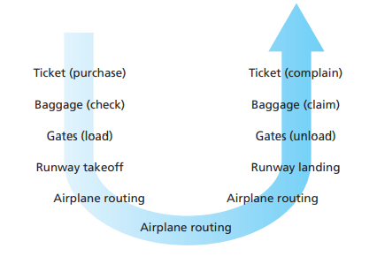
Layered Architecture
Human Analogy : Airline System
Taking an airplane trip: actions

Slide 77
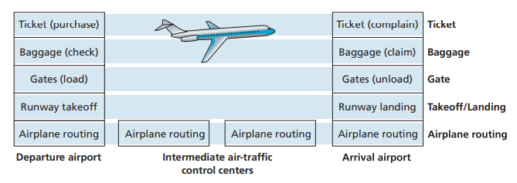
Layered Architecture
Each layer provides its service by :
performing certain actions within that layer
using the services of the layer directly below it
Horizontal layering of airline functionality

Slide 78
Layered Architecture
A Layered Architecture
a structured way to discuss system components
The system remains unchanged when a layer’s implementation is changed.
Note : changing the implementation of a service is very different from changing the service itself
The Internet protocol stack consists of five layers:
the physical,
link,
network,
transport, and
application layers

Slide 79
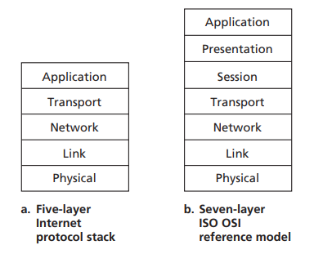
Protocol Layering
Network designers organize
Protocols and
The network hardware and software that implement the protocols — in layers
Taken together, the protocols of the various layers are called the protocol stack.

Slide 80
Layers of the Internet Protocol Stack
Application Layer
Network applications and their application-layer protocols reside
Application Layer Protocols :
HTTP protocol (for Web document request and transfer)
SMTP (for the transfer of e-mail messages)
FTP (for the transfer of files between two end systems)
An application-layer protocol is distributed over multiple end systems
packet of information at the application layer is a message

Slide 81
Layers of the Internet Protocol Stack
Transport Layer
Transports application-layer messages between application endpoints
This layer provides :
guaranteed delivery of messages to the destination and
flow control
Two transport protocols :
TCP
breaks long messages into shorter segments
provides a congestion-control mechanism
UDP
Provides a connectionless service to its applications
Transport-layer packet is a segment

Slide 82
Layers of the Internet Protocol Stack
Network Layer
Responsible for moving datagrams from one host to another
Network Layer Protocol :
IP Protocol
defines the fields in the datagram as well as how the end systems and routers act on these fields
Network layer contains routing protocols that determine the routes
Network-layer packet is a datagram

Slide 83
Layers of the Internet Protocol Stack
Link Layer
Responsible for moving entire frames from one network element to an adjacent network element
Services provided by the link layer depend on the specific link-layer protocol
Link Layer Protocols :
Ethernet
WiFi and
the cable access network’s DOCSIS protocol
Link Layer packets are frames

Slide 84
Layers of the Internet Protocol Stack
Physical Layer
Responsible for moving the individual bits within the frame from one node to the next
Protocols here are link dependent
Depends on the actual transmission medium of the link
Example :
twisted-pair copper wire
single-mode fiber optics etc

Slide 85
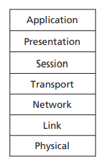
The OSI Model
Proposed in 1970s
ISO proposed that computer networks be organized around seven layers called the Open Systems Interconnection (OSI) model
The two additional layers present in the OSI reference model:
Presentation layer : allow applications to interpret meaning of data, e.g., encryption, compression, machine-specific conventions
Session layer : synchronization, checkpointing, recovery of data exchange

Slide 86
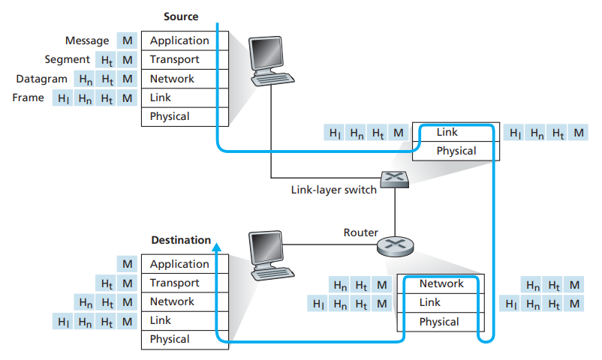
Encapsulation

Slide 87
Encapsulation
Routers and Link-layer switches do not implement all the layers in the protocol stack
they implement only the bottom layers
Internet routers can implement the IP protocol (a layer 3 protocol), while link-layer switches can not
Hosts implement all five layers

Slide 88
Concept of Encapsulation
At the sending host, an application-layer message M is passed to the transport layer
The transport layer takes the message and appends additional information (so-called transport-layer header information, H_{t} )
The application-layer message and the transport-layer header information together constitute the transport-layer segment
The transport-layer segment thus encapsulates the application-layer message
At each layer
a packet has two types of fields:
header fields and
a payload field
The payload is typically a packet from the layer above

Slide 89
NETWORK SECURITY
field of network security:
how bad guys can attack computer networks
how we can defend networks against attacks
how to design architectures that are immune to attacks
Internet not originally designed with (much) security in mind
original vision: “a group of mutually trusting users attached to a transparent network” ☺
Internet protocol designers playing “catch-up”
security considerations in all layers!

Slide 90
Bad guys: put malware into hosts via Internet
malware can get in host from:
virus: self-replicating infection by receiving/executing object (e.g., e-mail attachment)
worm: self-replicating infection by passively receiving object that gets itself executed
spyware malware can record keystrokes, web sites visited, upload info to collection site
infected host can be enrolled in botnet, used for spam. DDoS attacks

Slide 91
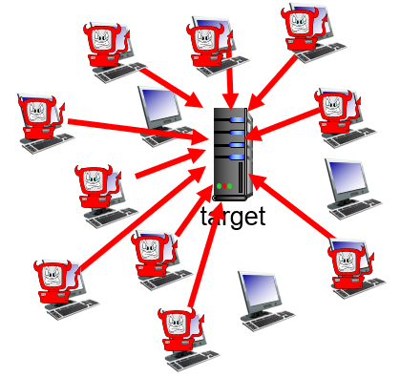
Bad guys: attack server, network infrastructure
Denial of Service (DoS): attackers make resources (server, bandwidth) unavailable to legitimate traffic by overwhelming resource with bogus traffic
select target
break into hosts around the network (see botnet)
send packets to target from compromised hosts

Slide 92
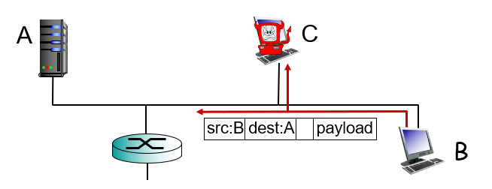
Bad guys can sniff packets
packet “sniffing”:
broadcast media (shared ethernet, wireless)
promiscuous network interface reads/records all packets (e.g., including passwords!) passing by
wireshark software used for end-of-chapter labs is a (free) packet-sniffer

Slide 93
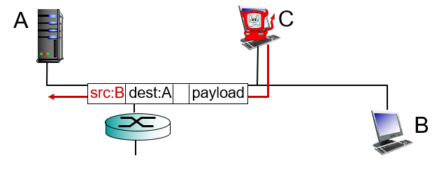
Bad guys can use fake addresses
IP spoofing: send packet with false source address

Slide 94
INTERNET HISTORY
1961-1972: Early packet-switching principles
1961: Kleinrock - queueing theory shows effectiveness of packet-switching
1964: Baran - packet-switching in military nets
1967: ARPAnet conceived by Advanced Research Projects Agency
1969: first ARPAnet node operational
1972: ARPAnet public demo
NCP (Network Control Protocol) first host-host protocol
first e-mail program
ARPAnet has 15 nodes

Slide 95
INTERNET HISTORY
1972-1980: Internetworking, new and proprietary nets
1970: ALOHAnet satellite network in Hawaii
1974: Cerf and Kahn - architecture for interconnecting networks
1976: Ethernet at Xerox PARC
late70s: proprietary architectures: DECnet, SNA, XNA
late 70s: switching fixed length packets (ATM precursor)
1979: ARPAnet has 200 nodes
Cerf and Kahn’s internetworking principles:
minimalism, autonomy - no internal changes required to interconnect networks
best effort service model
stateless routers
decentralized control
define today’s Internet architecture

Slide 96
INTERNET HISTORY
1980-1990: new protocols, a proliferation of networks
1983: deployment of TCP/IP
1982: smtp e-mail protocol defined
1983: DNS defined for name-to-IP-address translation
1985: ftp protocol defined
1988: TCP congestion control
new national networks: Csnet, BITnet, NSFnet, Minitel
100,000 hosts connected to confederation of networks

Slide 97
INTERNET HISTORY
1990, 2000’s: commercialization, the Web, new apps
early 1990s: ARPAnet decommissioned
1991: NSF lifts restrictions on commercial use of NSFnet (decommissioned, 1995)
early 1990s: Web
hypertext [Bush 1945, Nelson 1960’s]
HTML, HTTP: Berners-Lee
1994: Mosaic, later Netscape
late 1990’s: commercialization of the Web
late 1990s – 2000s:
more killer apps: instant messaging, P2P file sharing
network security to forefront
est. 50 million host, 100 million+ users
backbone links running at Gbps

Slide 98
INTERNET HISTORY
2005-present
~750 million hosts
Smartphones and tablets
Aggressive deployment of broadband access
Increasing ubiquity of high-speed wireless access
Emergence of online social networks:
Facebook: soon one billion users
Service providers (Google, Microsoft) create their own networks
Bypass Internet, providing “instantaneous” access to search, emai, etc.
E-commerce, universities, enterprises running their services in “cloud” (eg, Amazon EC2)

Slide 99


